Slide 1
Spark ML Summary

Slide 2
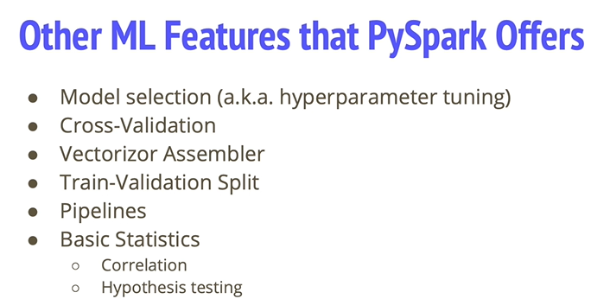
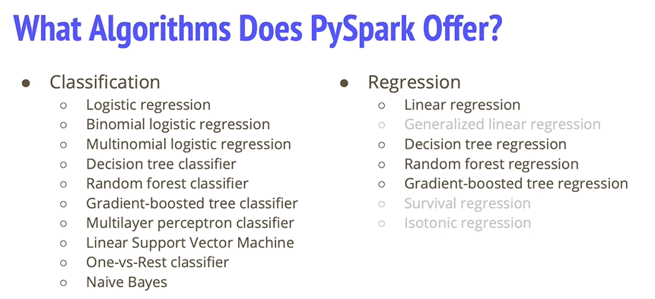
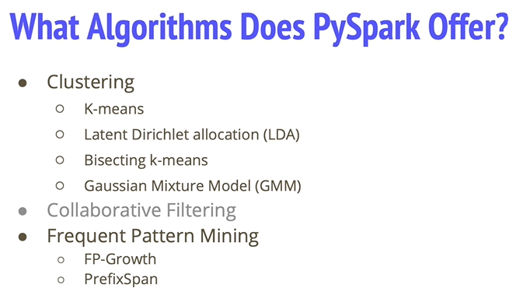

42. Intro to MLIB

Slide 3
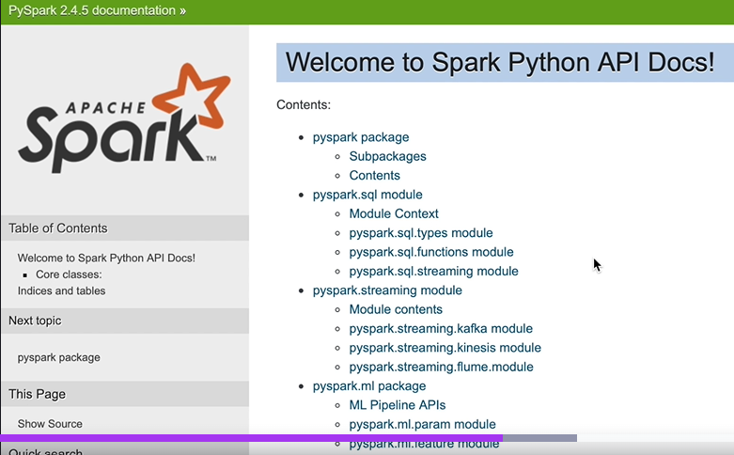
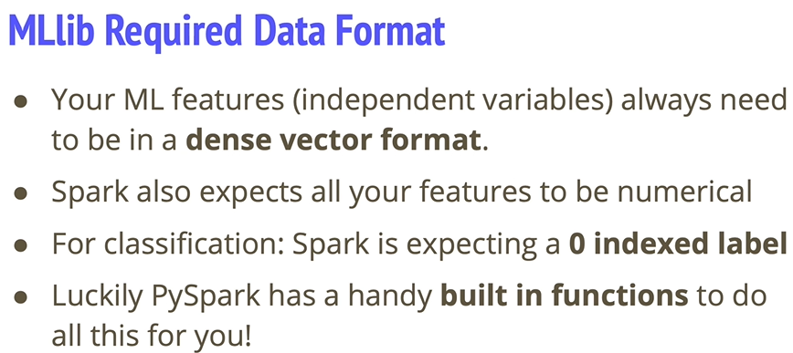
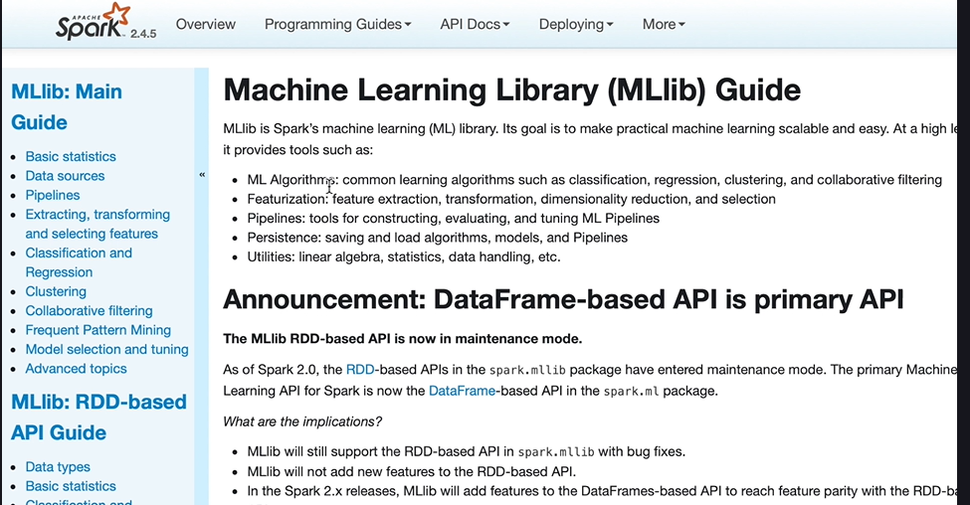
Notes:
1) You can see examples

Slide 4
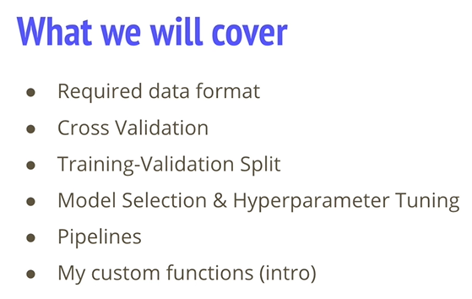
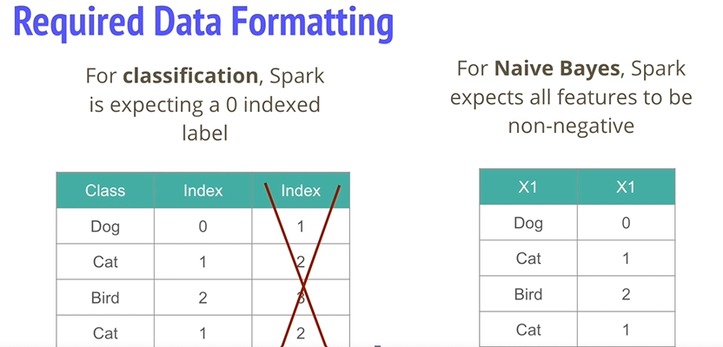
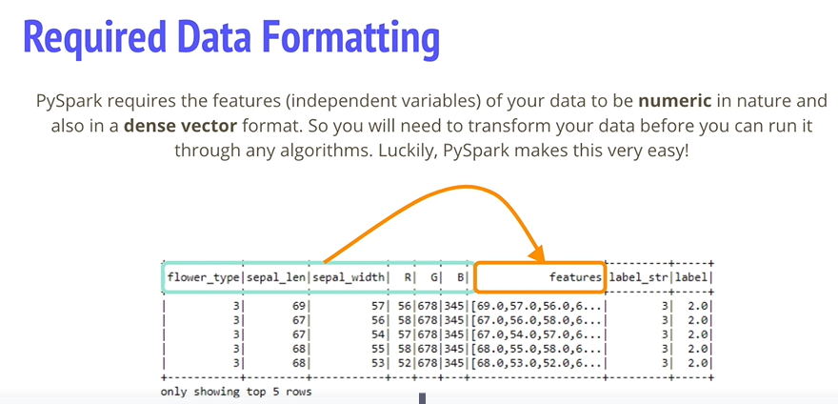
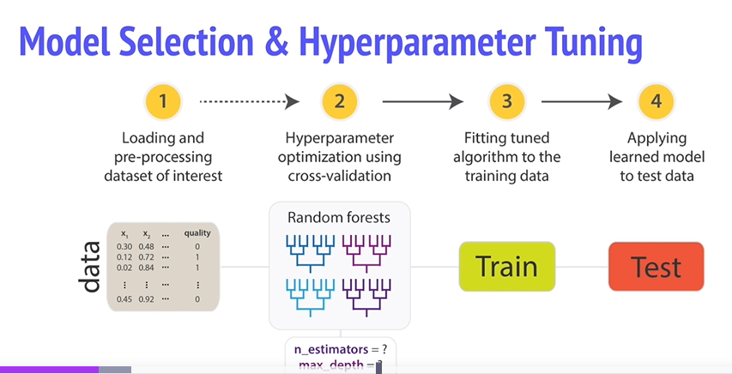
43. Model Selection and tuning.
Notes:
Note the use of her custom Functions
Note the required data format ..frame needs to be in
Need to transform your data into this format (array).
Whatch for custom scripts to featurize. Must name “label” and “features” respectively.
Note Zero based indexing
Can tune the entire pipeline at once

Slide 5
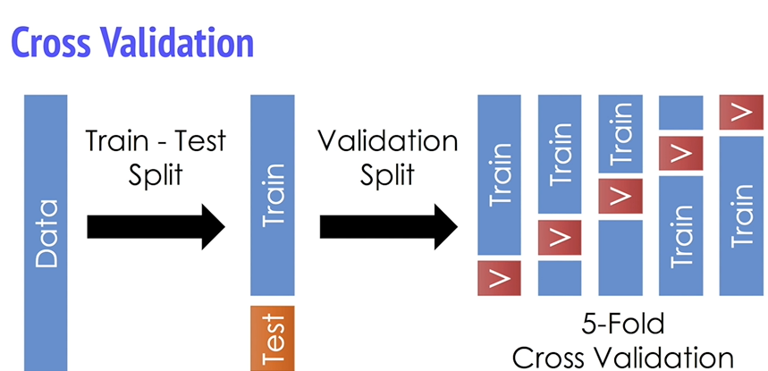
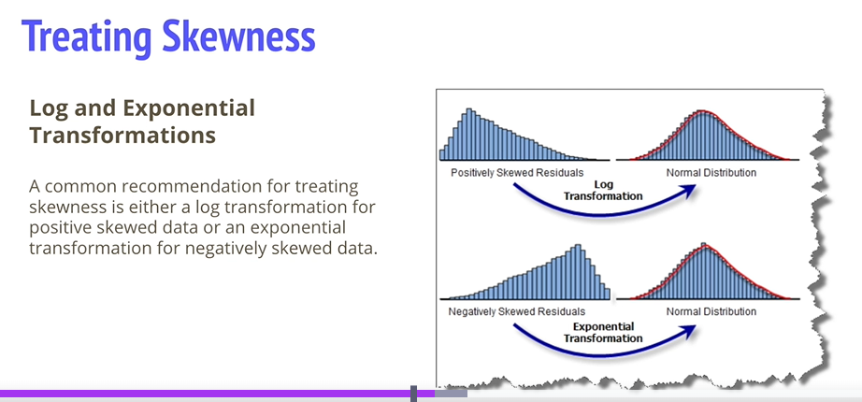
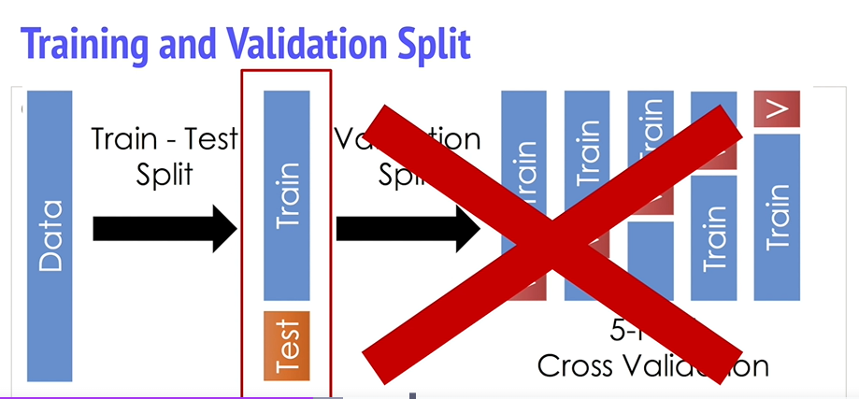
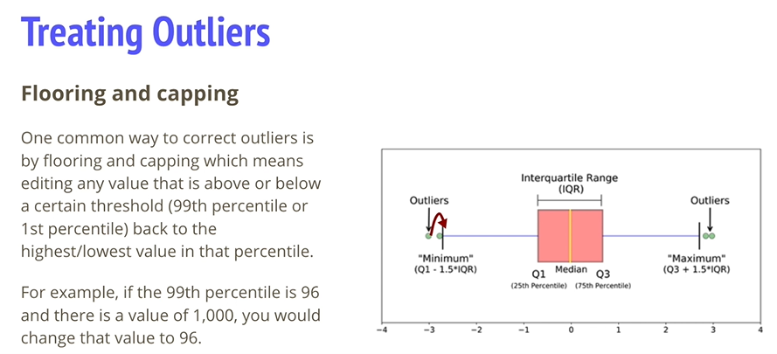
Cross validation
Notes:
Normal cv tunes params individually. 4 fits for training and 1 for test.
Average evaluartion over 5 folds

Slide 6
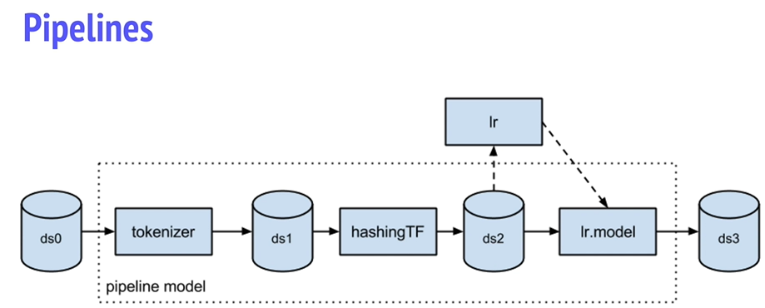
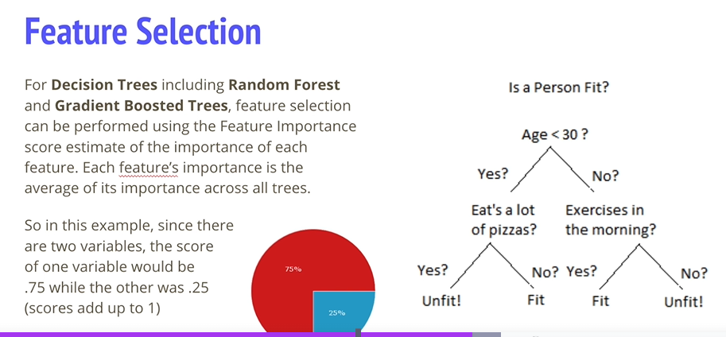
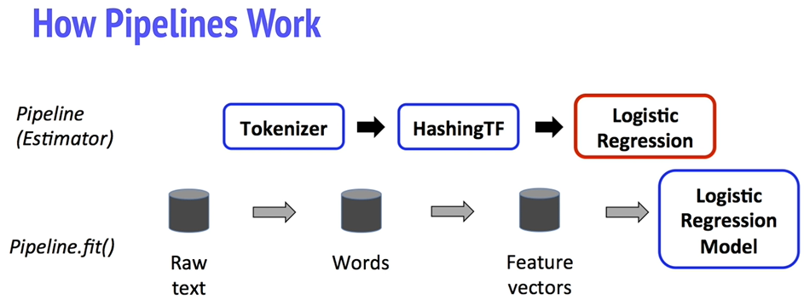
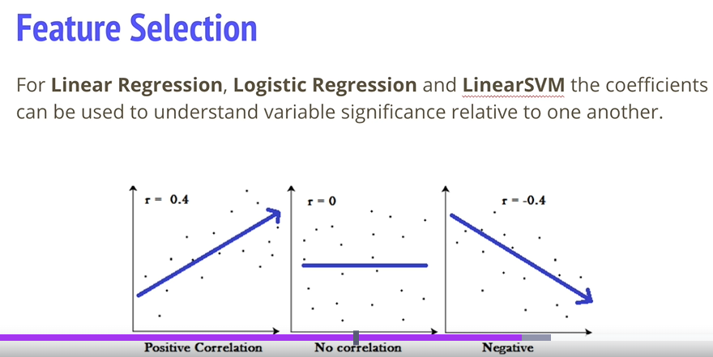
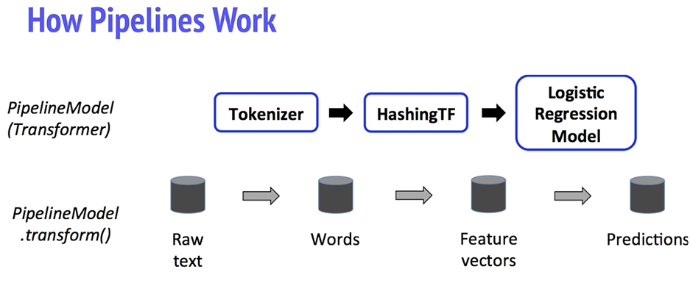
Notes:
ML Pipelines, transformers and estmators
Transformers… transform function , estimators , the fit method/
Tokenizer and Hashing TF , are transformers , log reg is the estimator
After the pipeline runs , it becomes a transformer , and is used to tranfsform the input df top predictions ; the pipeline model is used at test timer.
All estimators in the original pi[eline are now transformers.
Now we have test data , we move through the pipeline.
Pipelines ensure identiocal feature procfessing between train and test data.

Slide 7
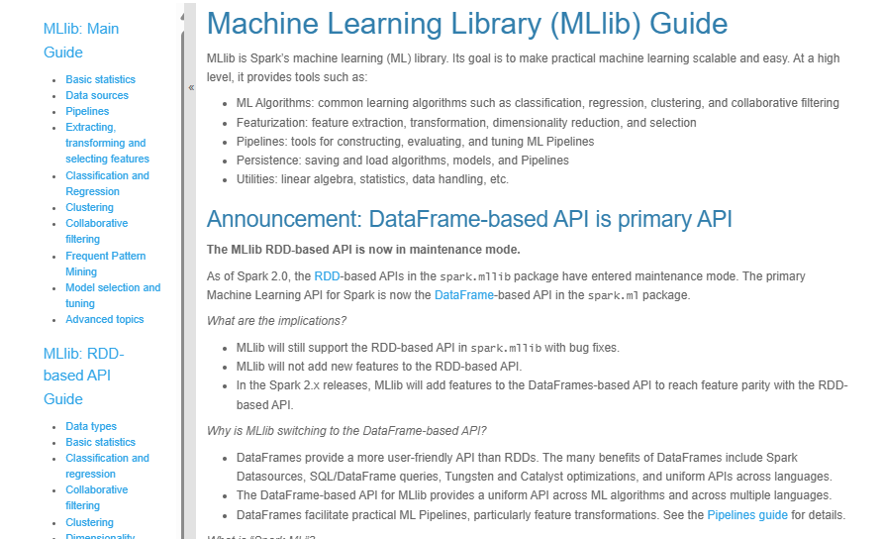
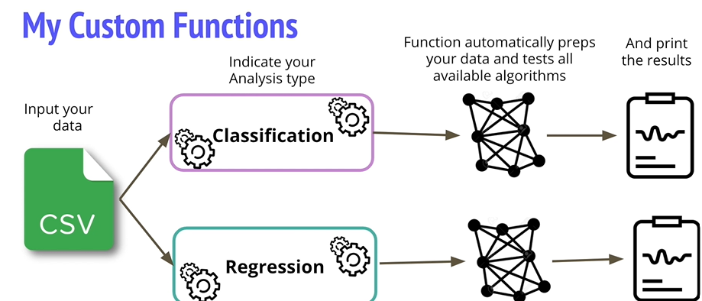

My Custom Functions
https://spark.apache.org/docs/latest/api/python/reference/pyspark.ml.html
https://spark.apache.org/docs/latest/ml-guide.html
Notes:
She has automal functions for us that do the lot.

Slide 8
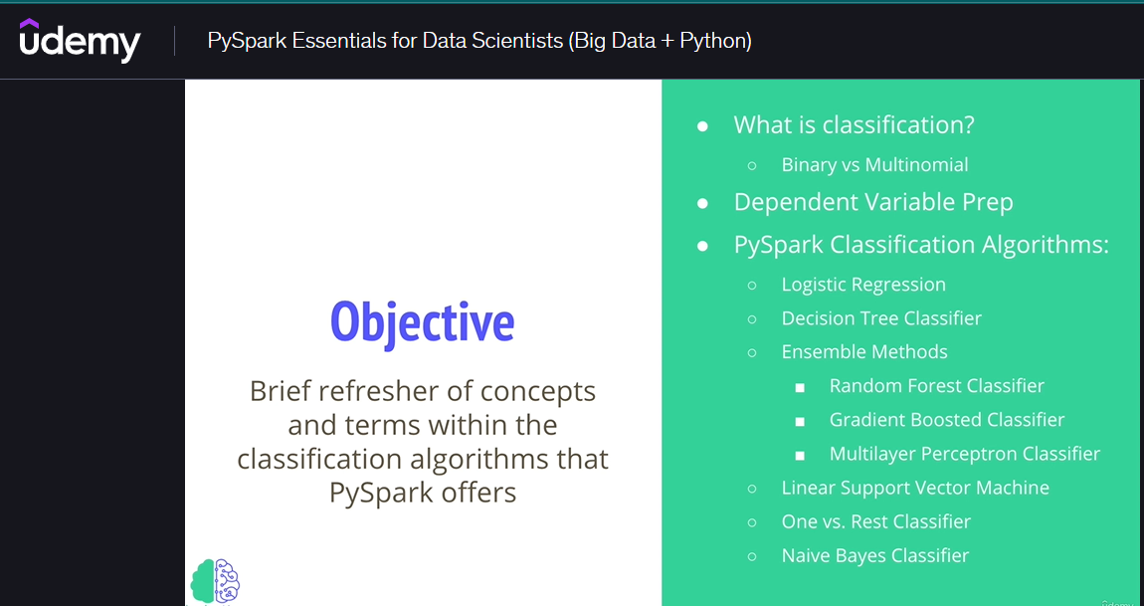
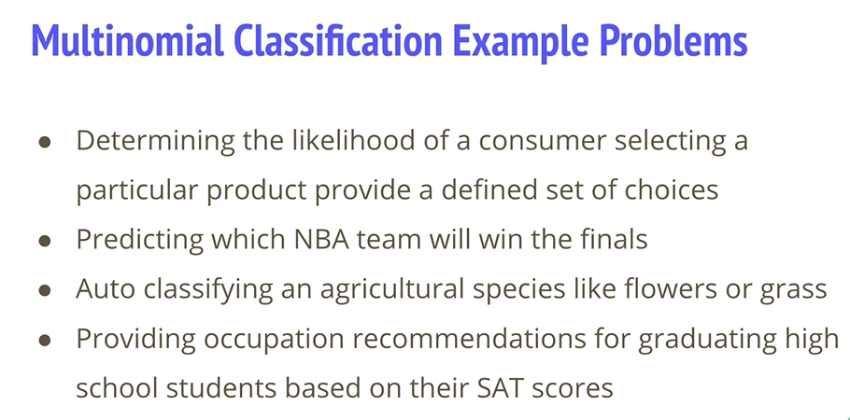
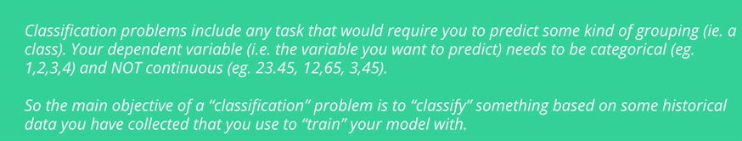
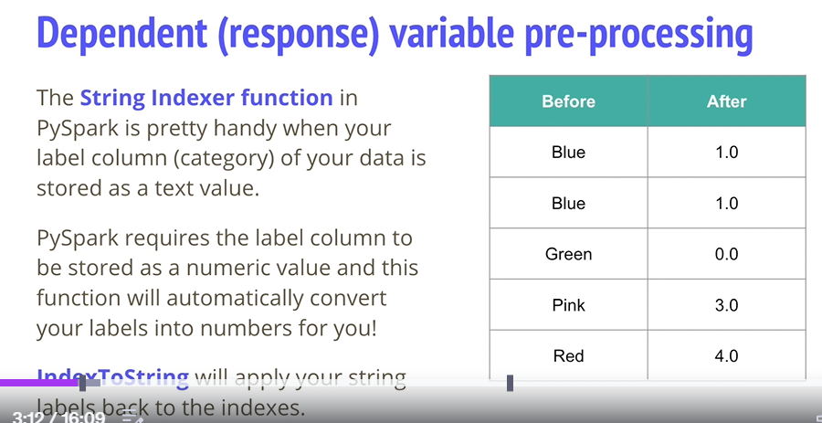
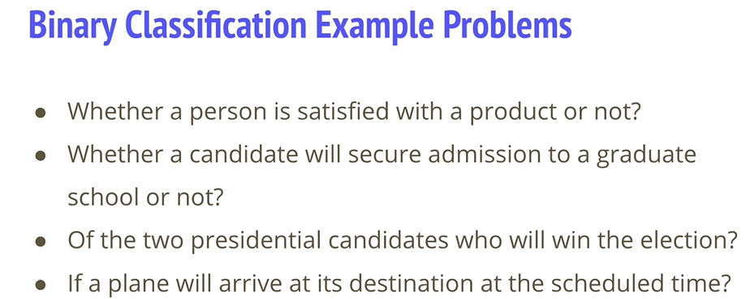
46. Intro to Classification
Notes:
NB , notice the stringIndexer , label col text to numbers
Reverse , apply string labels back to indexes.

Slide 9
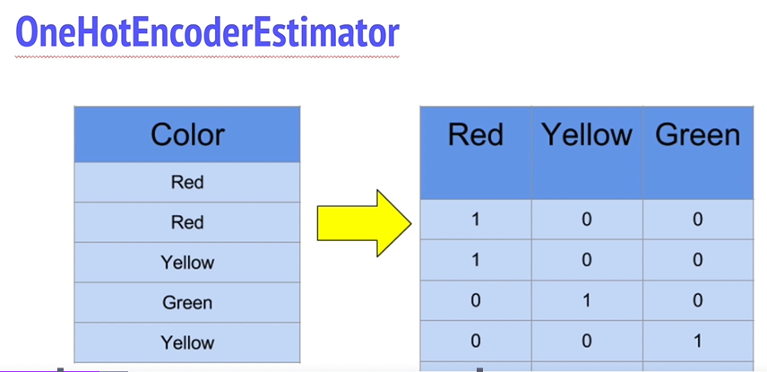
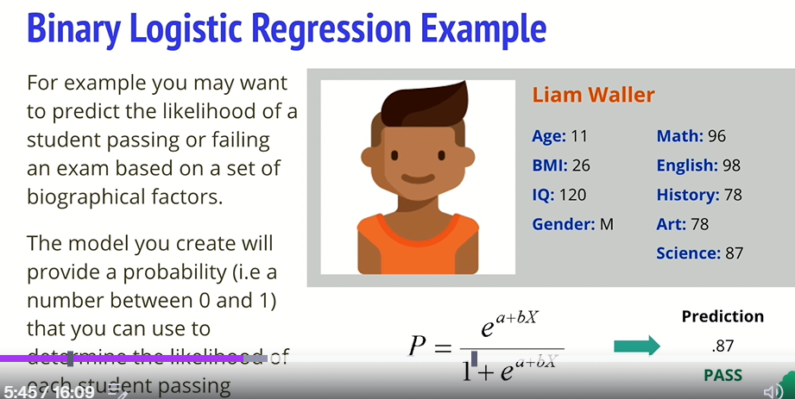
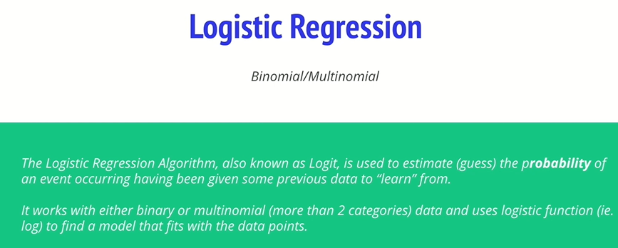
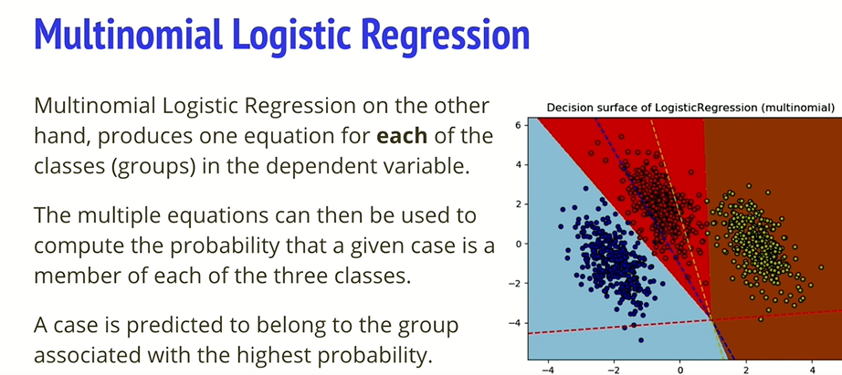
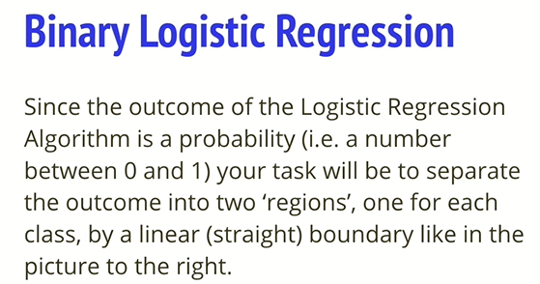
Notes:
Another method to applt string to numbers
Asses probability of event ..

Slide 10
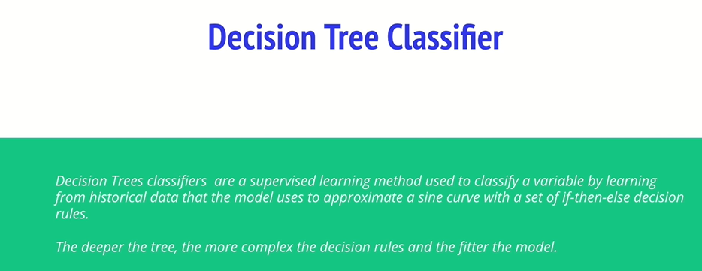
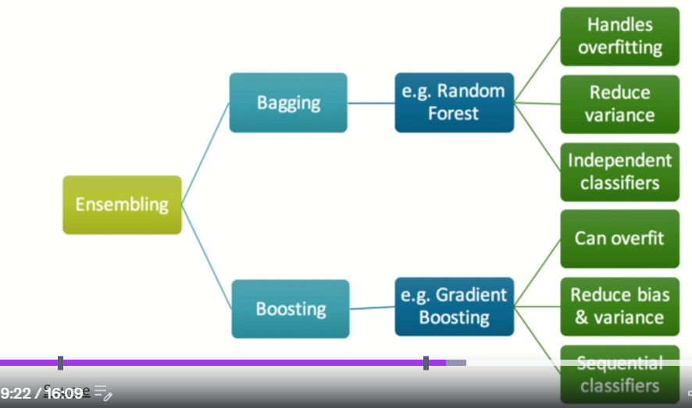
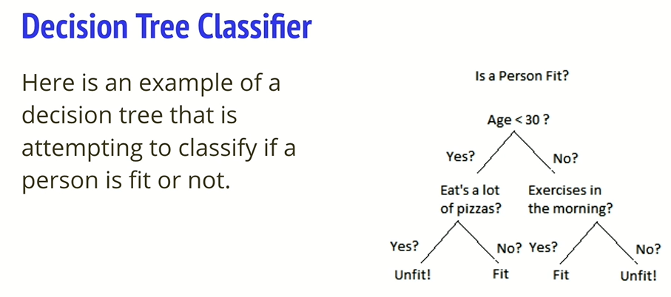
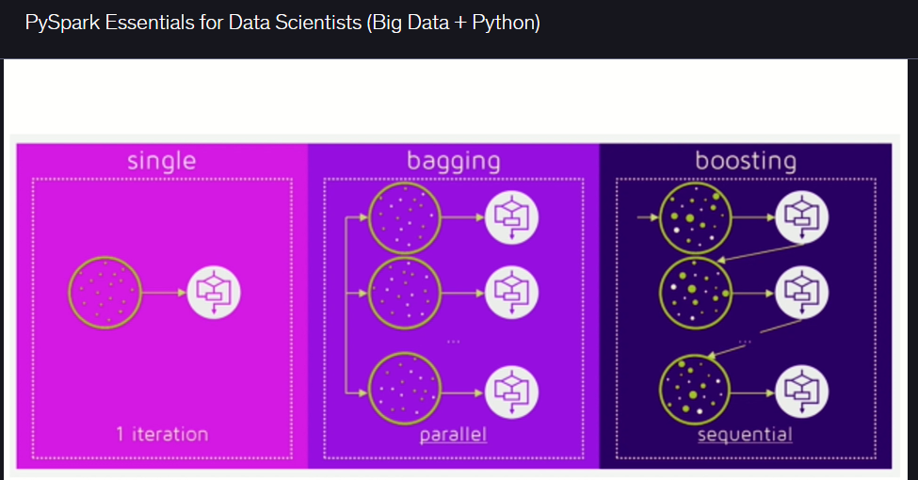
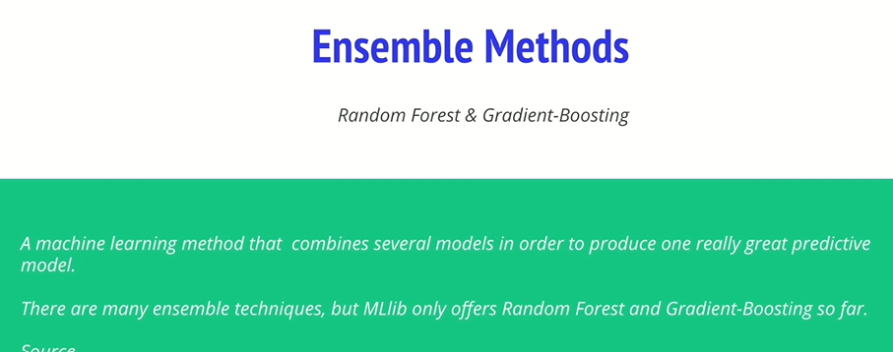
Notes:
Decision Tree high variance
See the nice comparison..
Notice how Boosting reduces Bias and Variance , but Random forest Reduces variance , but random forest handles over fitting , but Boosztin can overfit!
Notice the serial pattern of boosting, and the paral;el nature of bagging.
Bagging.. Parallel , max vote , choice .. Boosting serial on one another.
Boosting , less time to run ..learns from previous errors,

Slide 11
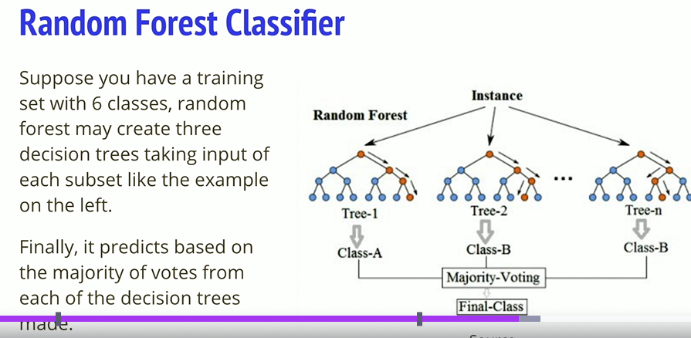
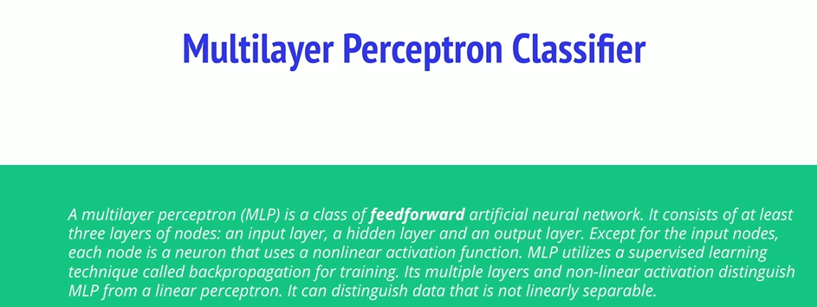
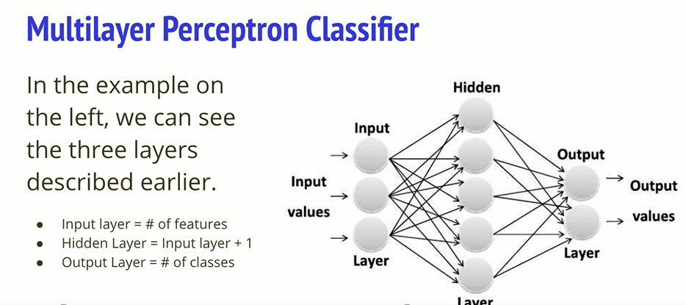
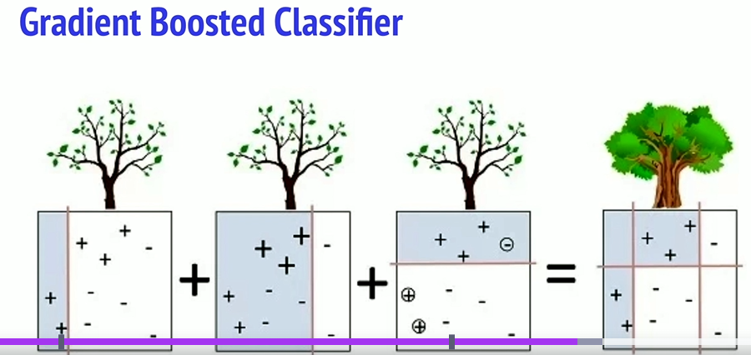
Notes:
Random Forest , majority class. Single tree prone to noise…
Gradient Boosting ..hierarchical approach., weak learners , define loss function and minimize it.
Input layer is the number of features , hidden gives more features , dependent on the previous features.

Slide 12

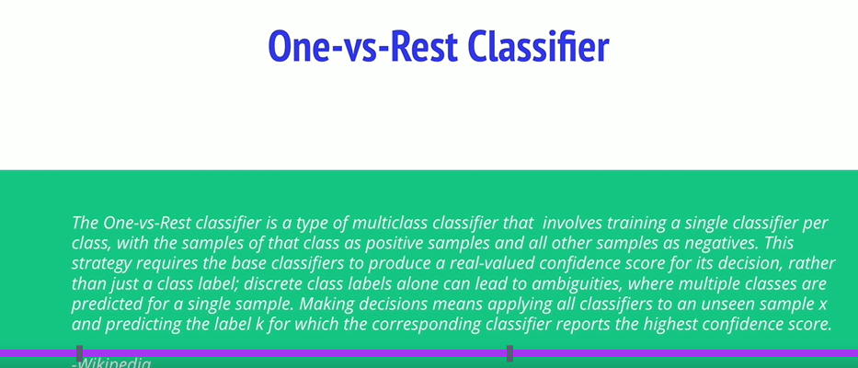
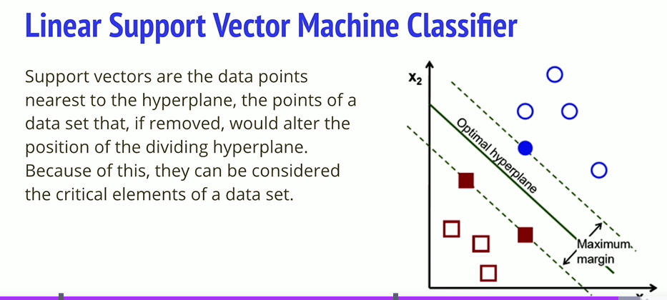
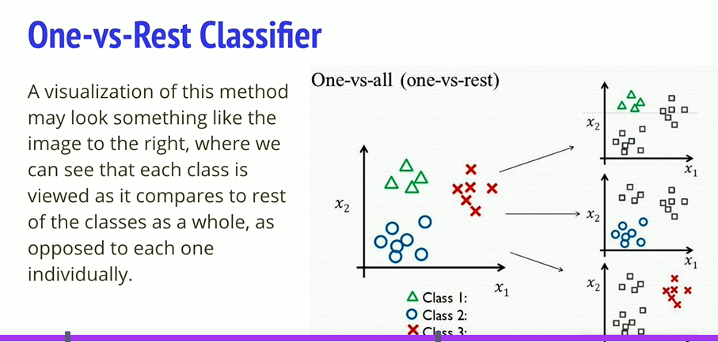
Notes:
1) One versus rest, unbalanced classes.

Slide 13
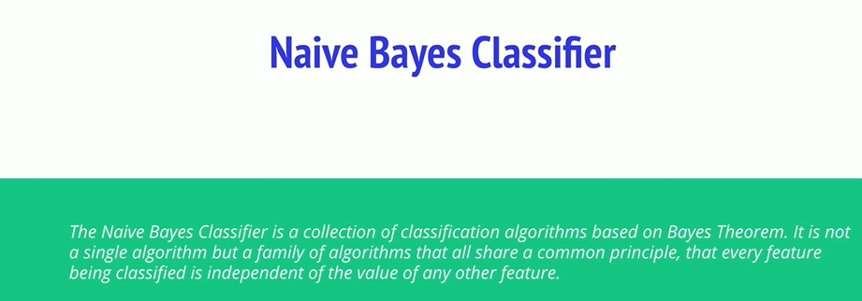
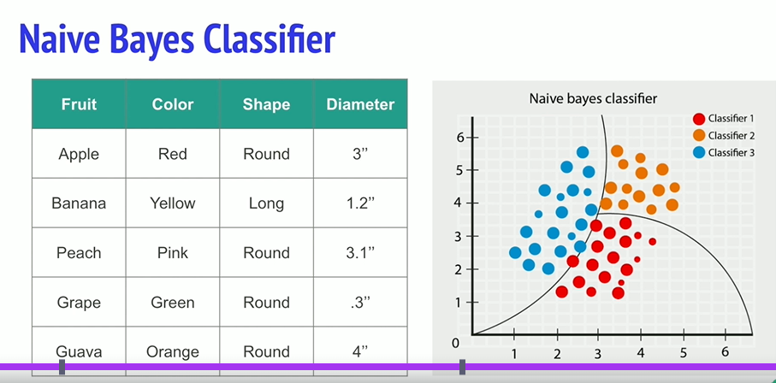
Notes:
Naïve Bayes , a family of algorithms that share a common principle
Each feature considered separatelty, regardless of an correlations between them!

Slide 14
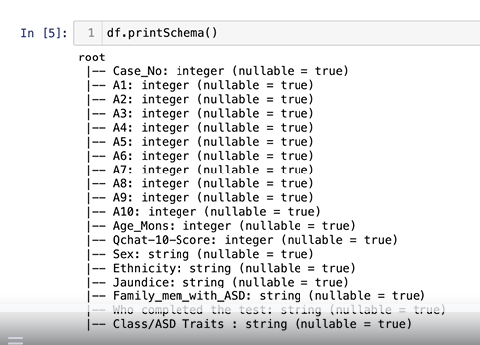
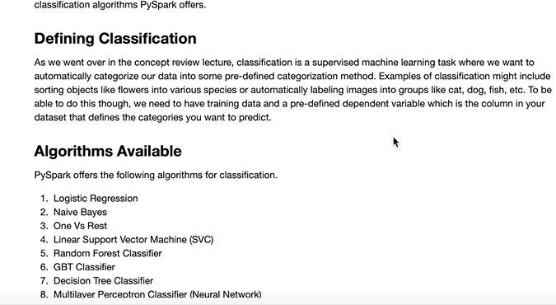
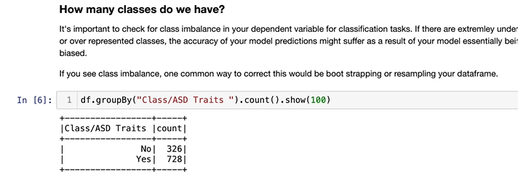
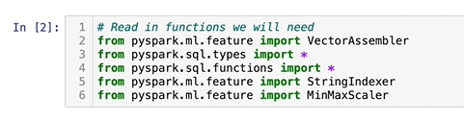
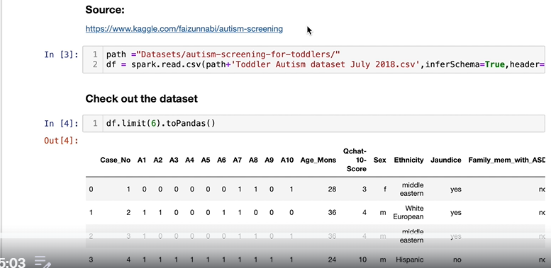

48. Coding Activity – Part 1 – Prep Data
Notes:
Very important to notice the functions we bring in
She goes through all the features..
Must [print out the schema. , we need to recode to numerical features.
Check to see the balance between classes., on the right , may be biased….rectified by bootstrapping or resampling the df.
< 1% would be bad.
Call dependent variable ..label. – do up front; click link under format data …to see material background in formatting data.

Slide 15





Formatting continued:
Notes:
Neeed all cols in list format. , We need a subset…,note the subsetting, not first or last.
Specify dependent variable., and reformat to numeric vars , zero indexed.
Note the use of the string Indexer function , and get the dependent var correct
We have to convert the stringtypesd to numeric of the indep vars
Code above changes the string to numeric
Check the Schema after the conversion to numerixc. To check al done.

Slide 16







Transformation example
Notes:
Makes a dictionary from top and bottom 1%, and correct the shewnees …if its greater than 1.
Take the log of it
When its greater or smaller than cap then at the gretaes and smallest of the 1%
There were no changes for this algorithm, then there was no skewnees
On the right we check for negative values , so wwe can use Naïve Bayes Classifier to the right.
We write code to detect the mins and collect the global minimum .. If that is less than zero. See top right
Df_minimum was > 0, so no zeros , no correction needed
Then we use Vector assembler to compute the feature from the features list (this is a model, or transformer.
We must call the assembler to do the transform.and get an output.
We found no negatives in our df , but Pyspark has a handy function to di this. , see bottom right.
Min,max scaler ..adjust any column to a scalar.
Note sclar is an extimator , therefore scalar .fit / Vector Assmbler is a tranfformer , so here we produce a scaler model.
And we run the datframe through this model. And show the result
Drop the column and renamed the scaled feature to features , for modelling purposes.
Use with ColumnRenamed.. Just to rename columns.
Train test split …
Ready to go modelling

Slide 17

49. Classification Part 2.0 Train and Evaluate(Intro)

Slide 18

Set up some Objects for Evaluation

Slide 19

50. Part 2 Classification: Train/Test [Logistic Regression]
Notes:
See link for more details, Very Simple Model.

Slide 20

Simple Logistic Model
Notes:
Notice AUC is most popular for Binary Classification and the accuracy score for multiclass problems.
Remember we created the Bin_Evaluator Object ..
We have a value odf 1 in our result because the features were highly prerdictive!.
She also uses the multioclas evaluator ..for Binary Classification!
We set up the MC Evaluator function ..previously.

Slide 21

Add in CV
Notes:
CV computes the average eval metric for all 5 folds
We have this parameter grid , and for each parameter combo. It gives average of all 5.
Choosdes best parameter grid value and refits using best parametres ON ENTIRE DATASET
Also choose best number of iteartions,

Slide 22

Parameter here is MaxIter, and sets a few values
Notes:
The paramGrid is 3 cols wide and 2 rows deep , ie grid fitted to both folds ….10,15,20 are the cols and numfolds are the rows.
Therefore 6 models and compare them.
Note in the Cross Validator you need all the 4 parameters: , estimator, estimatorParamsMap, evaluator,numfolds , should be 3+.
Fit and Extract best model …
By default ..the predictions = fitModel.transform(test) – uses the best model..
Note the cal to the evaluator to give the accuracy
There is a link to interpret the coefficients !

Slide 23

You can generate more detail on the Diagnostics ( Only available for Logistic Regression).
Notes:
See the lionk demystifying the confuysion matrix
False positive , true positive , precision and recall. See code aboce.
For multiclass classification you can do this on a per label basis ..
Scaled loss , must decrease on each iteration.

Slide 24

Now we call out False Positive rate , True positive rate , Precision and Recall for each label in multiclass
Notes:
1) Call out the Training Summary Object …

Slide 25

Print out confusion matrix metrics

Slide 26



Scaled loss metric is decreasing :
Notes:
See all the different metrics being printed out , from the previous code.
Read the article in the links.

Slide 27

1 Vs Rest
Notes:
1) Build whole lot of 1 vs rest for each level of classification.

Slide 28

Notes:
Firsrwe have the regularization parameter
Exact same setup as before

Slide 29


We then Fit the model
Notes:
Here we extract the best model
2) here we have multipler models
Model for each one of the classes , here we have 2 models , one for each class as its binary
Get all ther coeffoicients, see the rrewsults for both models.
See the intercepts are negatices of one another , due to the two classes, as well as the coefficients , they are inverse of one another .

Slide 30

Then get predictions and accuracy.
Notes:
Is 100% , theoretical.

Slide 31
Do others Later ie Multilayer PCP tron, Naïve Bayes , Linear SVM

Slide 32
Decision Tree Classifier

Slide 33

56. Decision Tree Algorithm:

Slide 34

Common Hyperparameters for decision treess

Slide 35


Slide 36

Codeing For Tree.. Very similar to others
Notes:
Notice where you specify , maxDepth , not done here and Maxbins , see all the options as a guide.,l
Notice how you get the feature importance scores.

Slide 37



57. Random Forest Model
Notes:
Say takes 3 decision trees ..get majority vote of all the trees.
Aggregate of many decision trees rerduced the effect of noise.
Same Hyperparameters as decision trees.
Feature Importance scores are the same as before
See the links in thed notebooks.

Slide 38


Coding for random Forest
Notes:
1) Very similar to that before

Slide 39

Notes:
1) See the most important features , can take out the less important features

Slide 40


58. Gradient Boosting
Notes:
Combines weak learners to strong prediction , allows flexible partitioning of feature space
Same Hyperparametres as before
Learn more in the link

Slide 41

GBM only accepots Binary Classification

Slide 42

Fit Model and Performance
Notes:
1) Feature importanbce scores are all tied..

Slide 43

60. Bonus: Add loop functions
Notes:
We noticed there is a lot of redundancy between algortithms ie hyperprarametres are very similar.

Slide 44

Unique Function ..Formatting data
Notes:
1) We bring in all the data , ie the predictor and feature columns , whether we must treat outliers etc.

